Slide 1
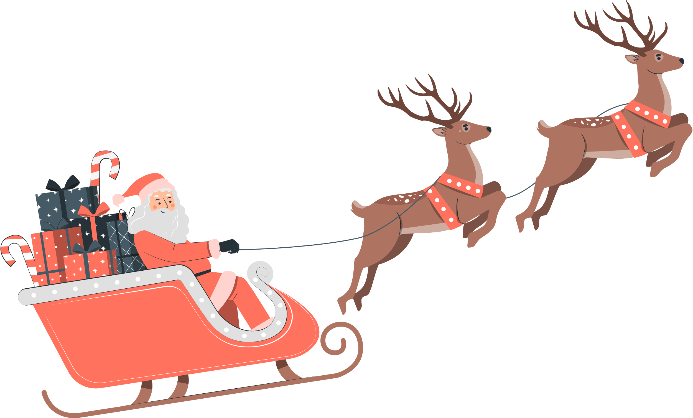

Slide 2
Created by

Slide 3
Created by

Slide 4
Created by

Slide 5
Created by

Slide 6
This Christmas; Experience The Joy Of Giving!
Happy Holidays!
Created by

